Slide 1

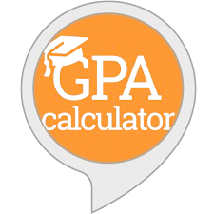
GPA CALCULATOR
Calculate Your GPA with Ease - Your Academic Success, One Click Away!

Slide 2
INTRODUCTION
The project aims to develop a web application for analyzing student performance based on internal exam scores.
It helps students identify weak areas and suggests improvements to achieve better grades in final exams.

Slide 3
EXISTING SYSTEM
Traditional methods involve manual calculation and analysis of student performance, which is time-consuming.
Present GPA Calculators does not provide Student feedback and improvement suggestions.
Feedback is often delayed, as it depends on teacher availability and manual review of scores.

Slide 4
ADVANTAGES
Personalized teacher feedback can provide nuanced understanding and motivation.
Does not rely on technology, making it accessible without internet or devices.
DISADVANTAGES
Manual processes are prone to human error and can be inconsistent in providing feedback.
Time delays in receiving feedback may hinder timely improvements in student performance.

Slide 5
PROPOSED SYSTEM
The system allows students to input their internal exam scores such as CAT marks , Assignment marks and their model practical marks and receive detailed performance analysis.
It provides notifications on required improvements and suggests target scores for achieving desired GPAs.

Slide 6
ADVANTAGES
The application offers personalized feedback, helping students focus on areas needing improvement.
Automated analysis and notifications save time and provide consistent insights.
DISADVANTAGES
The system relies on accurate data input; incorrect entries could lead to misleading analysis.
It requires internet access, limiting usability in areas with poor connectivity.

Slide 7
FUNCTIONAL REQUIREMENTS:
User Authentication: Secure login and logout for the users with email ID.
Marks Input: Enter and validate marks for up to three internal exams.
Performance Analysis: Identify weak areas and suggest improvements.
GPA Calculation Guidance: Provide feedback on scores needed for target GPA.
Notifications: Send performance updates and improvement suggestions.

Slide 8
NON FUNCTIONAL REQUIREMENTS:
Security: Sensitive data is encrypted and protected using secure login.
Usability: A user-friendly interface that is simple to use, even for non-technical users.
Performance: Quick response times are ensured for calculations and feedback.
Reliability: The application guarantees consistent availability and accurate results.

Slide 9
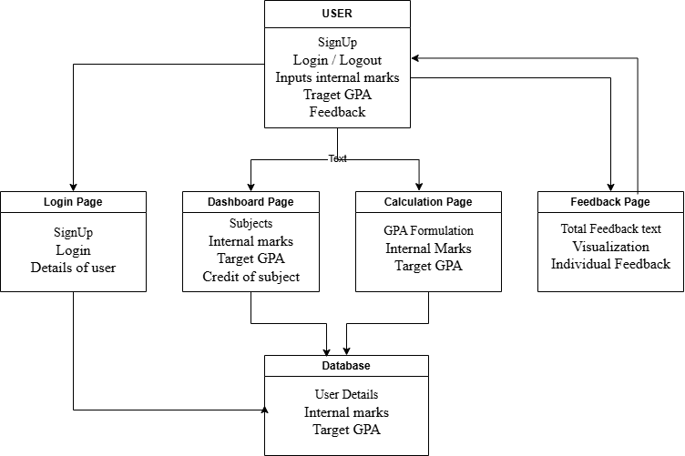
ARCHITECTURE DIAGRAM:

Slide 10
ARCHITECTURE DIAGRAM EXPLANATION:
The architecture of this GPA analysis web application consists of five main components. The User interacts with the system by signing up, logging in, and providing internal marks. The Login Page enables new users to sign up and existing users to log in. The Dashboard Page collects information about subjects, internal marks, and subject credits. The Calculation Page processes these inputs using GPA formulas to evaluate performance. Finally, the Feedback Page provides personalized feedback through text.

Slide 11
Module 1: Dashboard Module
The Dashboard Module serves as the central interface for user interaction and data management. It provides a clean and intuitive layout where users can input key data, such as internal marks, subject credits, and their target GPA. The dashboard dynamically displays a summary of the entered information, enabling users to track their progress effectively. Additionally, it allows easy navigation to other critical pages, including the GPA Calculation and Feedback modules, streamlining the workflow. The module is designed with a focus on usability, offering clear input forms, real-time updates, and error handling for invalid entries. By acting as a bridge between the input, calculation, and feedback processes, the Dashboard Module ensures users can seamlessly manage their academic data. Its responsive and interactive design provides a user-friendly experience, making it the cornerstone of the application’s functionality. This module promotes clarity and accessibility, empowering users to take control of their academic performance.

Slide 12
Module 2: GPA Calculation Module
The GPA Calculation Module is a vital part of the system, responsible for determining users' academic performance. It processes data entered on the dashboard, including internal marks and subject credits, to calculate an accurate GPA using a weighted formula. This formula accounts for the varying credit values assigned to different subjects and integrates predefined weightages for internal exams. The module also compares the calculated GPA with the target GPA set by the user, identifying gaps and providing actionable insights. It ensures accurate results by handling varying credit systems and subject combinations, making it adaptable to different curricula. The outputs generated are seamlessly passed to other modules, such as Feedback and Visualization, for further processing. Robust error handling ensures smooth operation even with incomplete or incorrect data. The GPA Calculation Module serves as the backbone of the system, providing reliable results to help users monitor and improve their academic performance.

Slide 13
Module 3: Feedback Module
The Feedback Module delivers personalized and comprehensive insights into the user’s academic performance. Based on the calculated GPA and its comparison with the target GPA, it generates actionable feedback in both textual and visual formats. The textual feedback includes specific suggestions, such as subjects requiring improvement, and highlights performance gaps to help users meet their academic goals. The module also employs data visualization techniques, such as bar charts and pie charts, to represent GPA trends and subject-wise performance visually. These visual aids simplify the interpretation of data, enabling users to quickly identify strengths and weaknesses. The Feedback Module ensures that users receive both quantitative and qualitative evaluations of their performance. By combining analytical insights with interactive visualizations, it creates a user-centric experience that is both informative and engaging. This module is essential for guiding users toward achieving their academic objectives effectively.

Slide 14
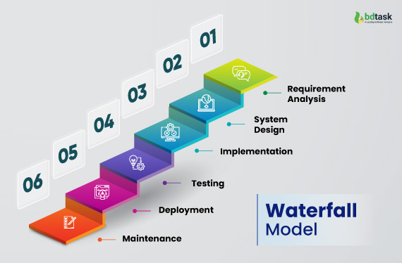
WATERFALL MODEL:
The Waterfall Model is a linear and sequential approach that consists of several phases.
The GPA Analysis Web Application project follows the Waterfall Model, which ensures a structured and sequential development process. In the Requirements Phase, we gathered detailed requirements for login, marks input, GPA calculations, and feedback. The Design Phase focused on creating a clear architecture and choosing technologies. During Implementation, each module, from authentication to GPA analysis, was developed individually. This was followed by Integration and Testing to verify that all components worked together seamlessly.

Slide 15
TESTING (UNIT TESTING)
Unit testing is a technique used to verify that individual parts of a program function as expected. In your GPA calculator project, unit tests are essential for ensuring accuracy in key functions, such as `calculateSubjectInternal`, `updateCourses` and `populateSubjects`, which handle GPA calculations and internal exam breakdowns. These tests confirm that calculations are correct under various scenarios, like perfect grades or different credit distributions, verifies the calculation of internal GPA contribution based on given inputs, ensures subjects are correctly populated into the container and tests whether the course dropdown is populated correctly based on the regulation selection.This accuracy is crucial, as incorrect GPA calculations could lead to misleading feedback for students. By isolating and testing each function, unit testing helps detect errors early, improves code reliability, and allows safe modifications to the project over time. Overall, unit testing ensures that the feedback provided to students is accurate and dependable.

Slide 16
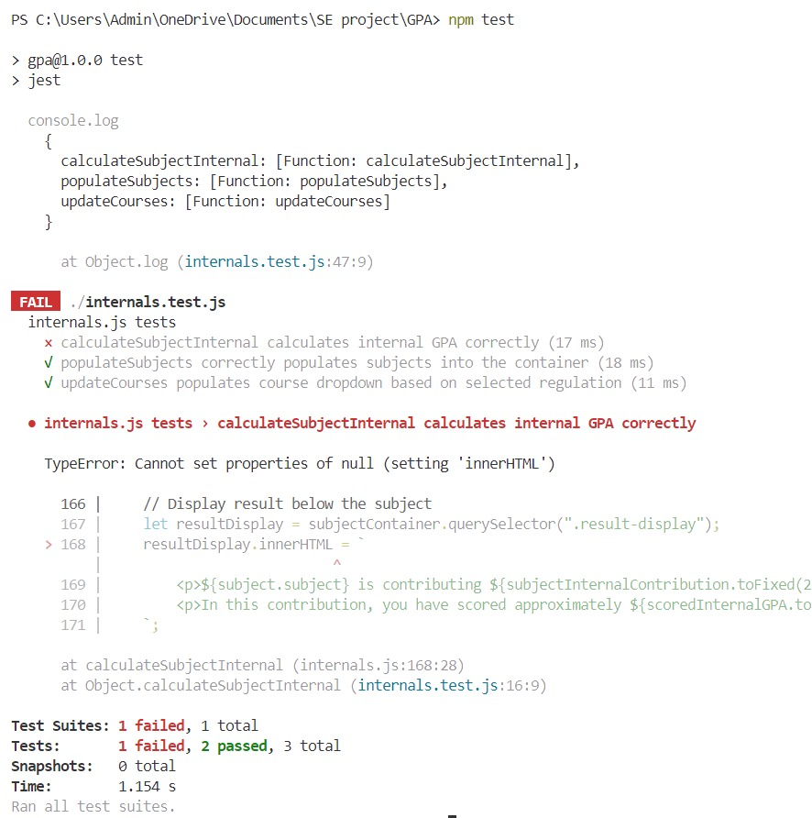
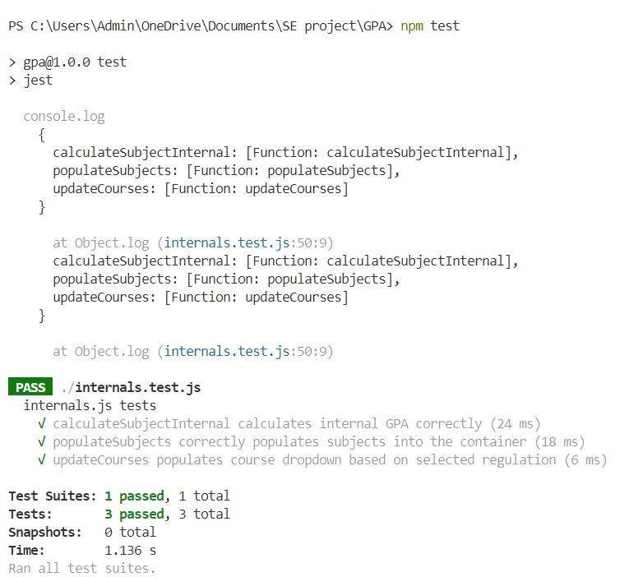
TESTING OUTPUTS:

Slide 17
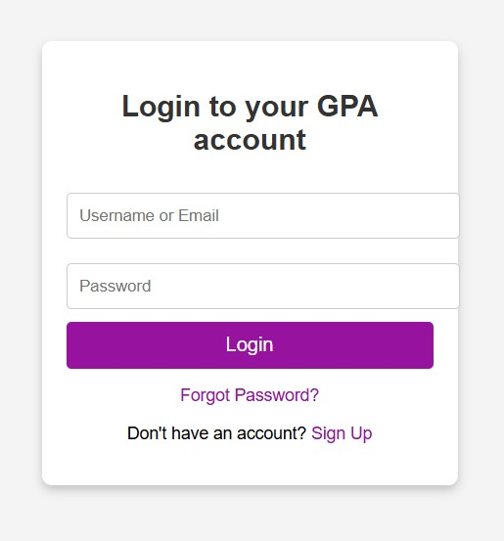
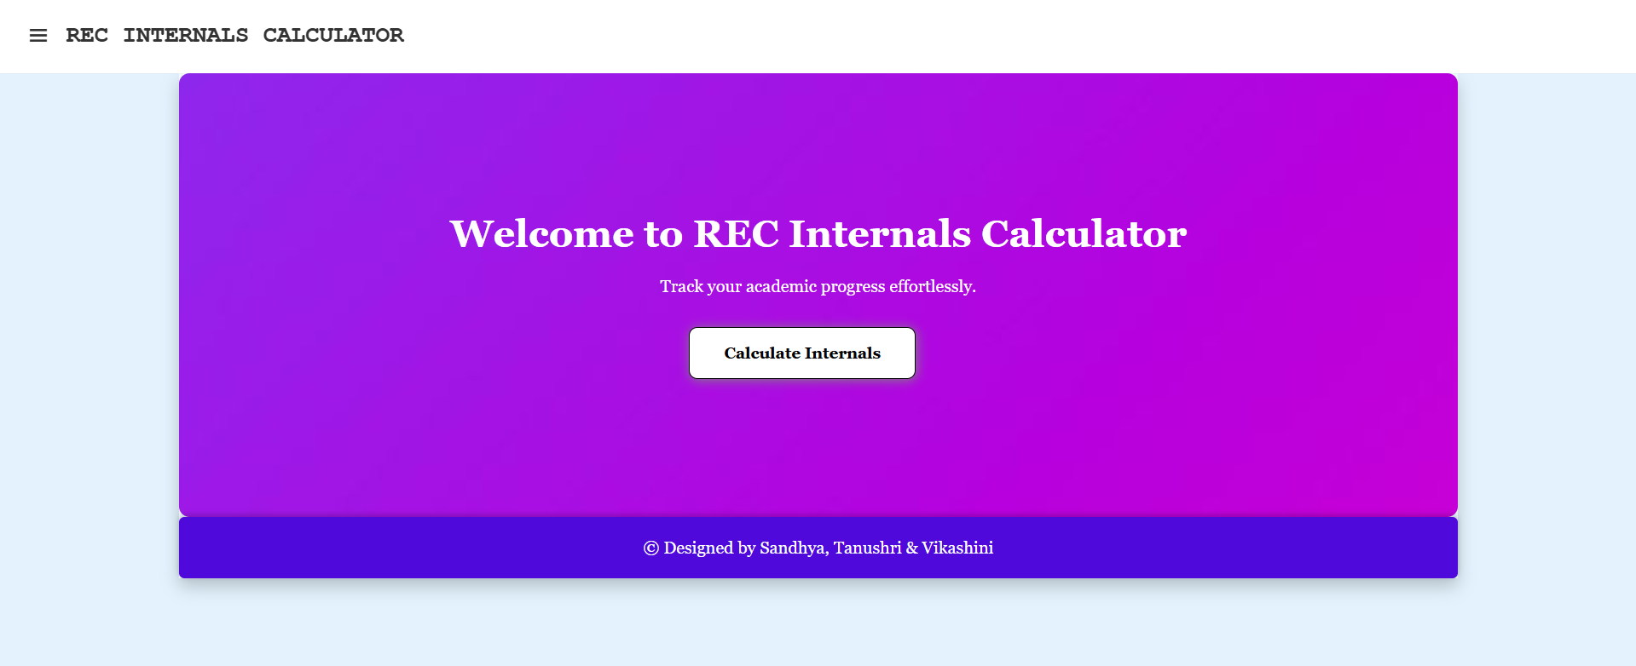
OUTPUT SCREENSHOTS:

Slide 18
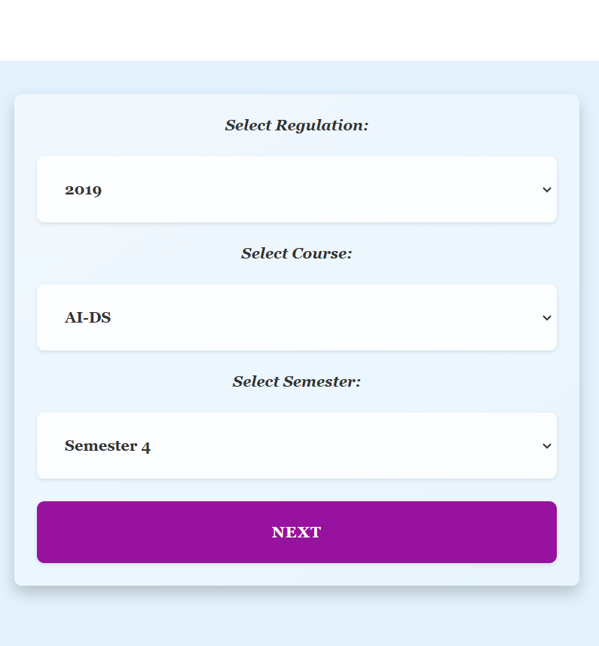
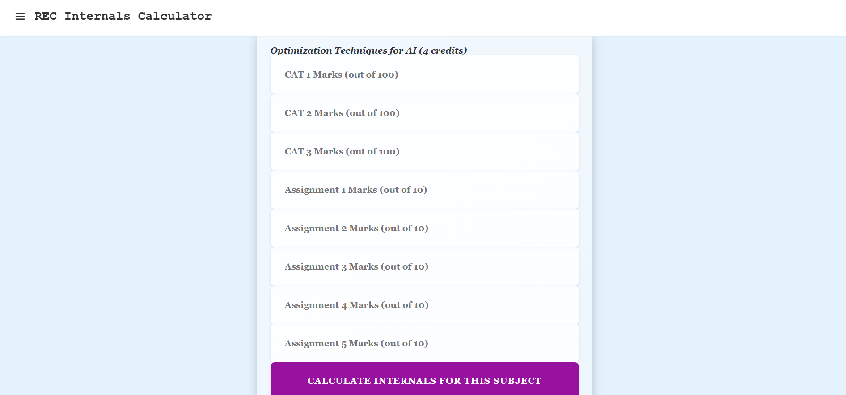
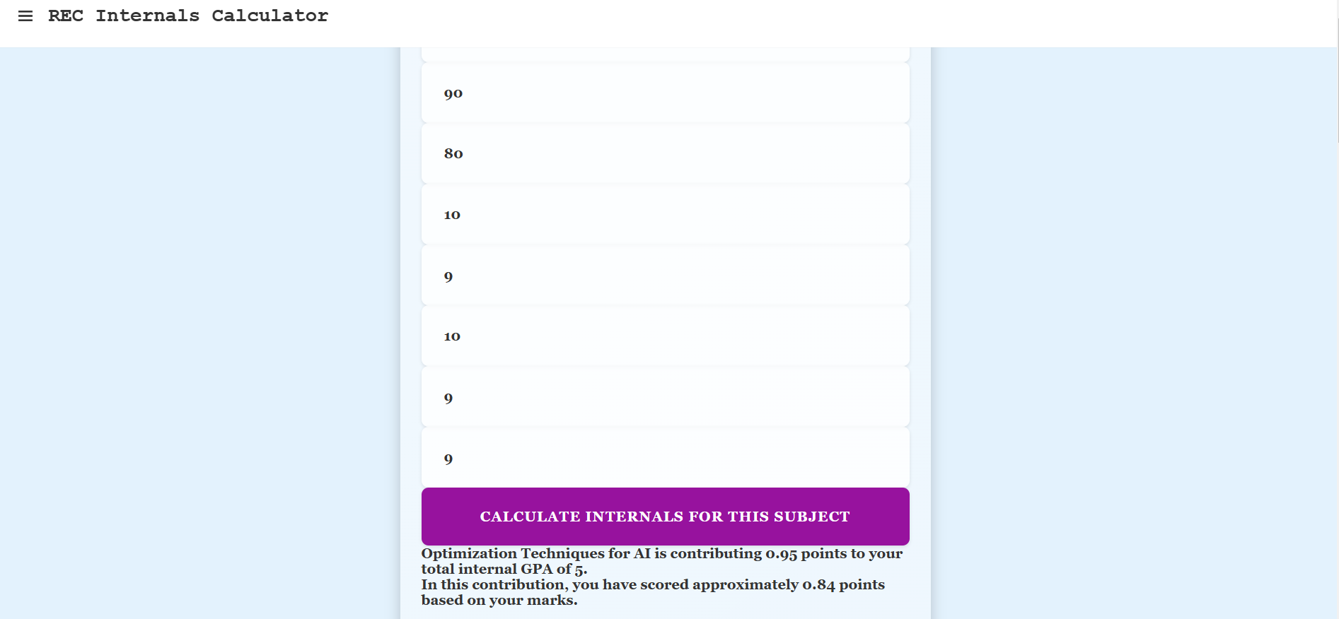

Slide 19


Slide 20
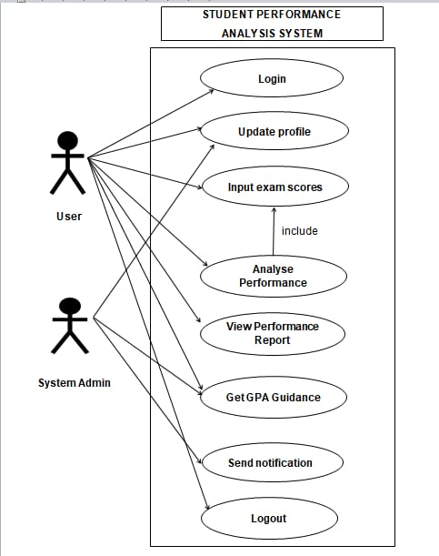
USE CASE DIAGRAM
The diagram outlines the various use cases associated with the system, showing how both actors interact with the system to accomplish different tasks. The central focus is on the analysis of student performance, including the input and assessment of exam scores, generating reports, and providing guidance based on input scores.

Slide 21
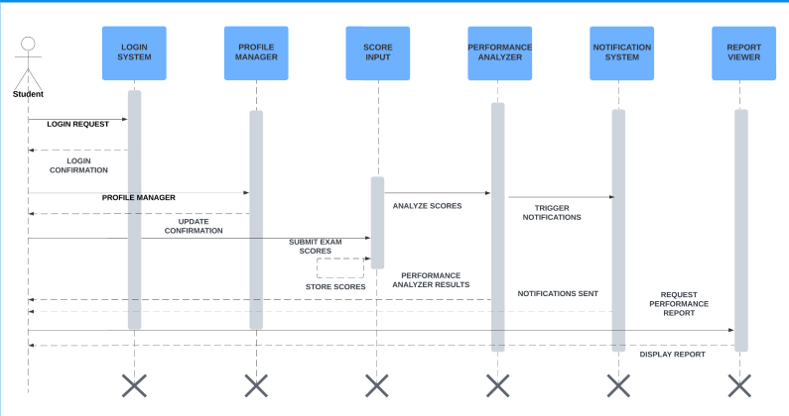
SEQUENCE DIAGRAM
The Sequence Diagram for the "Student Performance Analysis System" illustrates the step-by-step interaction between a student and the system components. It begins with the student logging in, followed by profile updates and score submission. The system then analyzes the scores, triggers notifications, and finally displays the performance report .

Slide 22
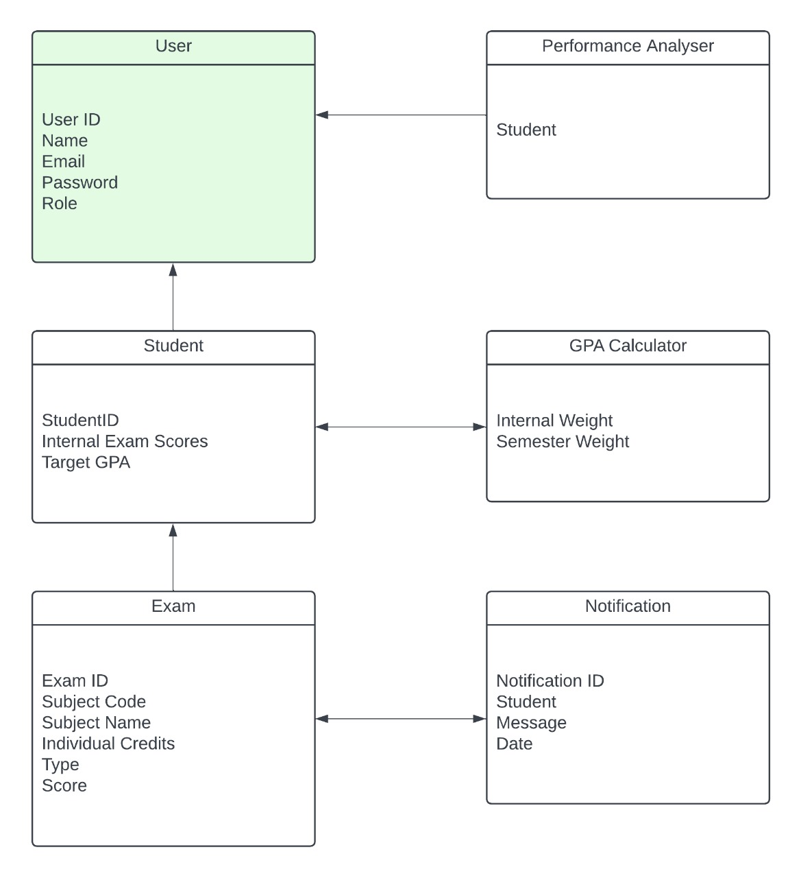
CLASS DIAGRAM
The class diagram illustrates the relationships between different entities in a student performance analysis system. The main classes include User, Student, Exam, Performance Analyser, GPA Calculator, and Notification. These classes manage student data, exam details, performance analysis, GPA calculation, and notifications, with attributes such as `User ID`, `Student ID`, `Exam Scores`, and `Notification ID` defining their roles and connections within the system.

Slide 23
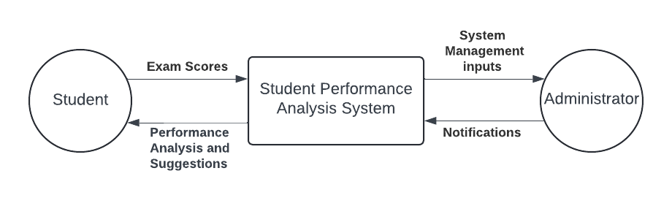
DATA FLOW DIAGRAM
LEVEL 0

Slide 24
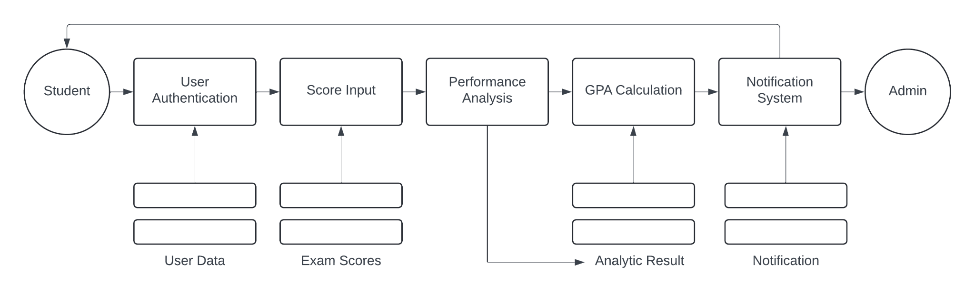
DATA FLOW DIAGRAM
LEVEL 1

Slide 25
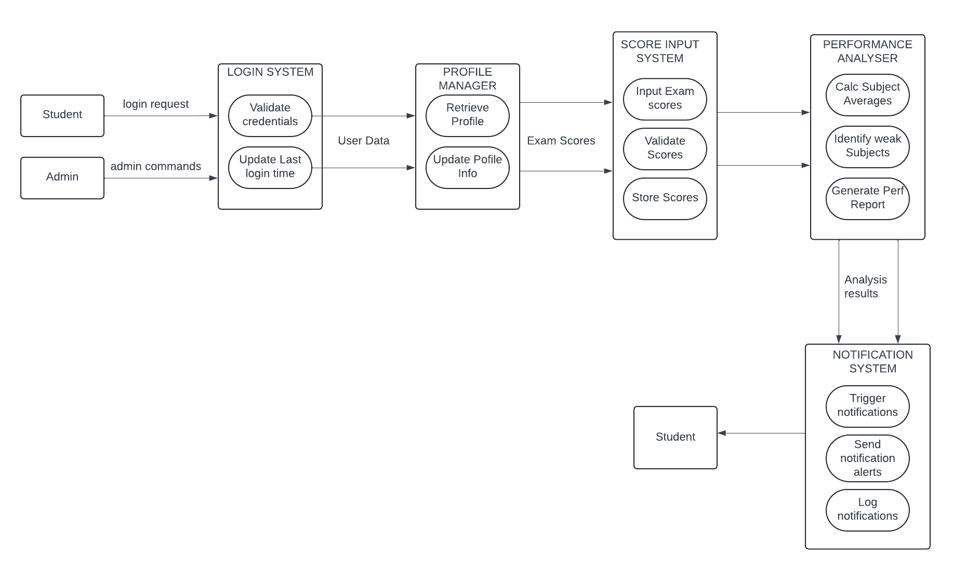
DATA FLOW DIAGRAM
LEVEL 2

Slide 26
RESULTS AND DISCUSSIONS:
The GPA Analysis web application successfully provides students with insights into their academic performance by analyzing internal exam marks and obtaining feedback based on their inputs to achieve their target scores. The dashboard enables flexible input for any number of subjects, ensuring adaptability to various curricula. The feedback generated includes personalized suggestions, empowering students to focus on subjects where improvement is needed. Testing validated the application's functionality, confirming accurate GPA calculations and secure login processes. Discussions indicate that this tool is beneficial for academic self-assessment, guiding students toward enhanced semester performance.

Slide 27
FUTURE SCOPE:
This project could be expanded by integrating predictive analytics to forecast GPA trends based on historical data, helping students set realistic goals. Adding support for teachers to provide direct feedback on student progress could further personalize the learning experience. Additional modules for tracking attendance and extracurricular performance would create a more comprehensive student profile. Mobile app compatibility would allow easier access, and data anonymization techniques could make the tool applicable across multiple educational institutions, aiding administrators in assessing student performance trends on a larger scale.

Slide 28
CONCLUSION:
The GPA Analysis web application is a valuable tool that addresses the need for academic self-assessment among students. By consolidating internal marks and delivering feedback, it empowers students to understand their strengths and areas needing improvement. Implemented with the Waterfall model, this project went through systematic phases, ensuring reliability and functionality. The user-friendly design and informative visual feedback contribute to enhancing the academic experience, preparing students better for their semester exams. Overall, this project highlights the potential of technology in fostering educational growth and student empowerment.

Slide 29
REFERENCES:
1. Balachandran, V., & Radhakrishnan, V. (2019). Educational Data Mining for Student Performance Prediction. Journal of Educational Technology.
2. Gupta, P. (2020). Flask Web Development: Developing Web Applications with Python. O'Reilly Media.
3. Kumar, A., & Singh, R. (2021). Predictive Analytics in Academic Performance. International Journal of Education and Research.
4. Sharda, R., & Delen, D. (2017). Business Intelligence and Analytics. Pearson Education.
5. Pedregosa, F., et al. (2011). Scikit-learn: Machine Learning in Python. Journal of Machine Learning Research.
6. Flask Documentation. (n.d.). Retrieved from https://flask.palletsprojects.com/
7. SQLAlchemy Documentation. (n.d.). Retrieved from https://www.sqlalchemy.org/
8. Matplotlib Documentation. (n.d.). Retrieved from https://matplotlib.org/
9. Jain, P., & Bansal, R. (2022). Advancements in Data Visualization for Educational Analytics. Educational Data Journal.
10. Dhir, P. (2018). Feedback Mechanisms in Digital Learning. Learning Analytics Journal.

Slide 30
THANK YOU

